Slide 1






MapTek
Hire-me Coder
Group PG05

Slide 2


CONTENTS
01 Introduction
02 Technology Kits
03 Project Process
04 User Journey
05 Achievement
06 Conclusion

Slide 3
1
Introduction
A general description about the project and Hire-me Coder

Slide 4
Introduction
A general description about the project and Hire-me Coder
The main purpose of this project is to develop a system which can check the candidate coding ability could that can match the Maptek requirement.
This project is a web-based application and obtained both administrator and interviewees.
Candidates have particular time period to complete the online test.
Administrators can have access to verify the candidate answers

Slide 5
2
Technology Kits
Technology used in developing the Hire-me Coder

Slide 6




Technology Kits
Technology used in developing the Hire-me Coder
Development Tools
Frontend: PUG & Bootstrap
Backend: Node.JS
Database: Firebase

Slide 7



Technology Kits
Technology used in developing the Hire-me Coder
Cooperative Tools
Communication: Slack
Cloud & Version control: GitHub
Kanban & To-do list: Trello

Slide 8
3
Project Process
The detailed processes of the whole project

Slide 9
Project Process
The detailed processes of the whole project
Week 1-3
Week 7-9
Sprint 1
Sprint 3
Project Conception and Initiation
Milestone 1
Week 4-6
Week 10-12
Sprint 2
Sprint 4
Project Definition and Planning
Milestone 2

Slide 10
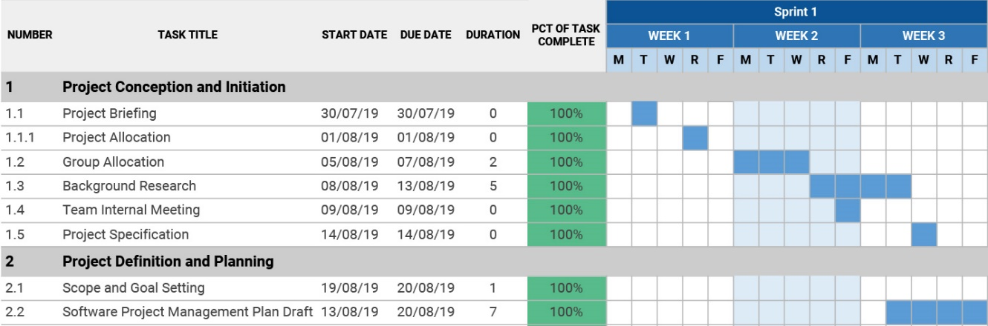
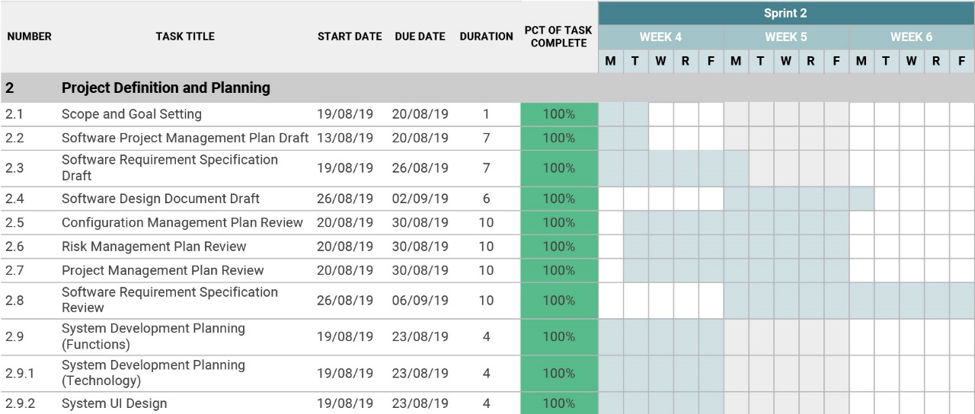
Project Process
The detailed processes of the whole project
Sprint 1
Sprint 2

Slide 11
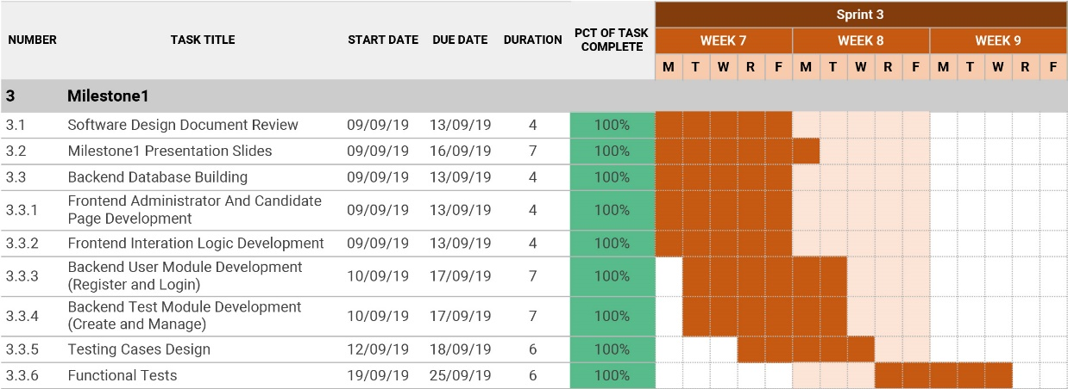
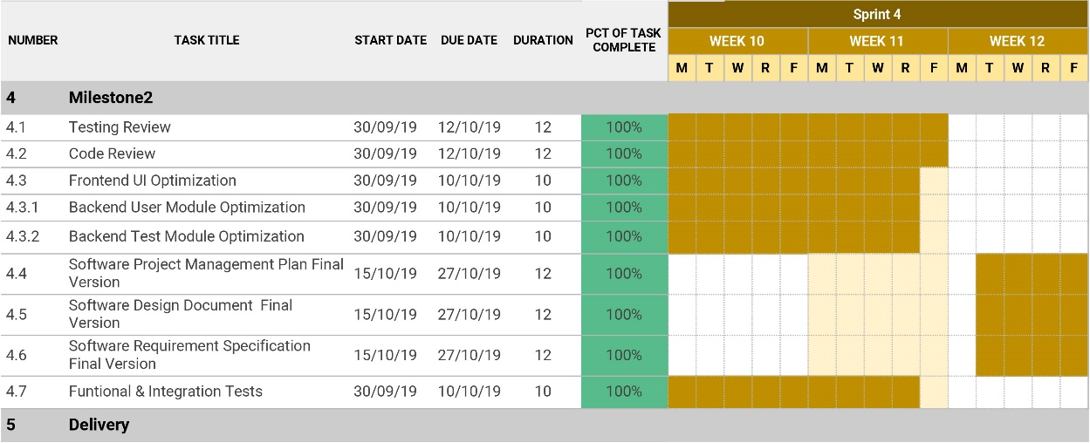
Project Process
The detailed processes of the whole project
Sprint 3
Sprint 4

Slide 12
4
User Journey
The experiences of users on the Hire-me Coder

Slide 13
User Journey
The experiences of users on the Hire-me Coder
Administrator question management
Question preparation
Question describe/File/Picture/Question dialog
Multiple questions
Administrator Test sending
Test setting
Candidate email
Multiple sending/Email syntax address verification
Question selecting
Expiate date and time
Email preview
Administrator User management
Adding new user
Active and deactivate
Users profile edit
Candidate Test Participating
Test email
Test link/Candidate account/Candidate password
Test page
Test notification/Due date alert/Answer saving/Answer submitting
User profile
Profile editing
First name and last name/Address cannot be modified
Rest Password
Password confirm/Twice input of new password
Forgot Password

Slide 14
5
Achievement
The achievements of milestones

Slide 15
Achievement
The achievements of milestones
Milestone 1 | Status
Login system for administrators | Finish
Manage users in admin mode | Finish
Create questions and tests | Finish
Preview tests | Finish
Milestone 2 | Status
Receive the email | Finish
Update the password | Finish
Attempt the tests and submit the tests | Finish
Save the test and attempt it again later | Finish

Slide 16
6
Conclusion
A conclusion of the project and further improvement

Slide 17
Conclusion
A conclusion of the project and further improvement
This new solution is help to reduce the time for every individual person.
Better utilization for both admin and candidate.
Increase the candidate satisfaction and performance.
Further we can implement video interview option, quick result for interviewee or candidate.

Slide 18
Thank You
Group PG05

